Slide 2

This Photo by Unknown Author is licensed under CC BY-SA

Slide 3
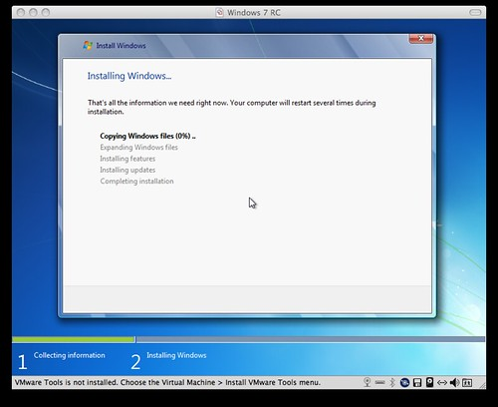
This Photo by Unknown Author is licensed under CC BY-SA

Slide 4
1%
This Photo by Unknown Author is licensed under CC BY-SA

Slide 5
10%
This Photo by Unknown Author is licensed under CC BY-SA

Slide 6
10%
This Photo by Unknown Author is licensed under CC BY-SA

Slide 7
10%
This Photo by Unknown Author is licensed under CC BY-SA

Slide 8
20%
This Photo by Unknown Author is licensed under CC BY-SA

Slide 9
20%
This Photo by Unknown Author is licensed under CC BY-SA

Slide 10
20%
This Photo by Unknown Author is licensed under CC BY-SA

Slide 11
20%
This Photo by Unknown Author is licensed under CC BY-SA

Slide 12
30%
This Photo by Unknown Author is licensed under CC BY-SA

Slide 13
100%
This Photo by Unknown Author is licensed under CC BY-SA

Slide 14
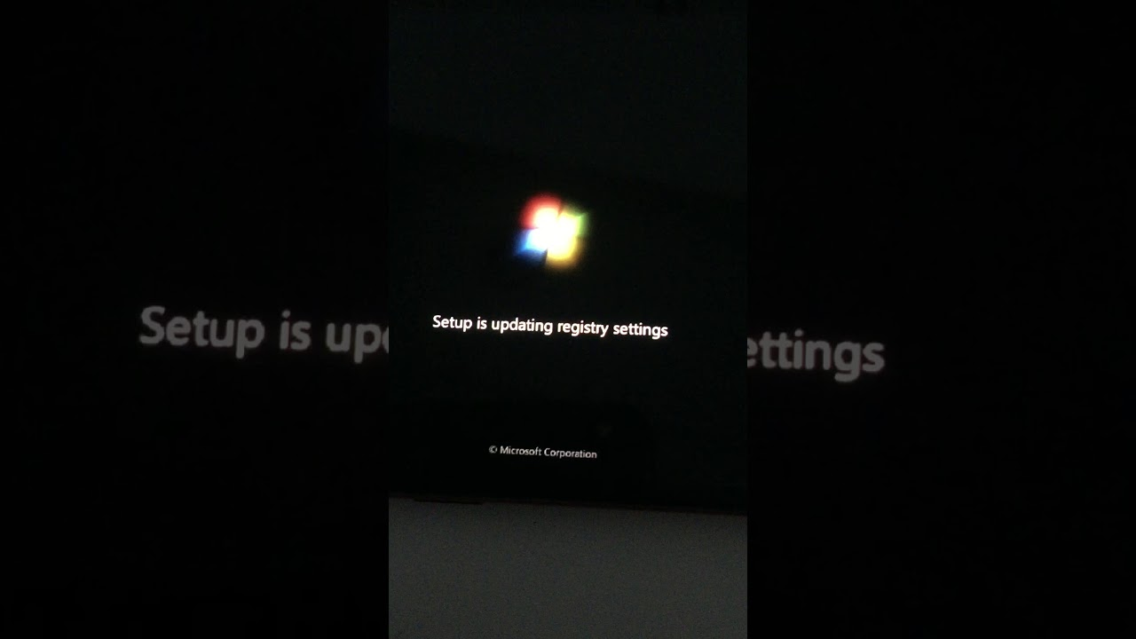

Slide 15
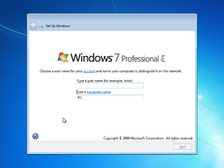
This Photo by Unknown Author is licensed under CC BY-SA

Slide 16
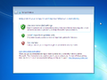
This Photo by Unknown Author is licensed under CC BY-SA

Slide 17
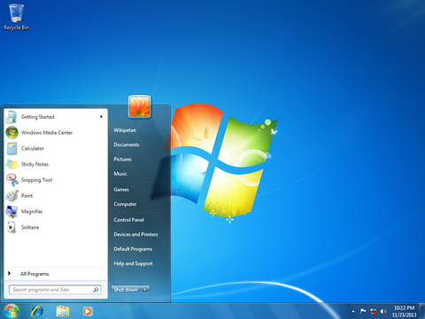
This Photo by Unknown Author is licensed under CC BY-SA-NC

Slide 18
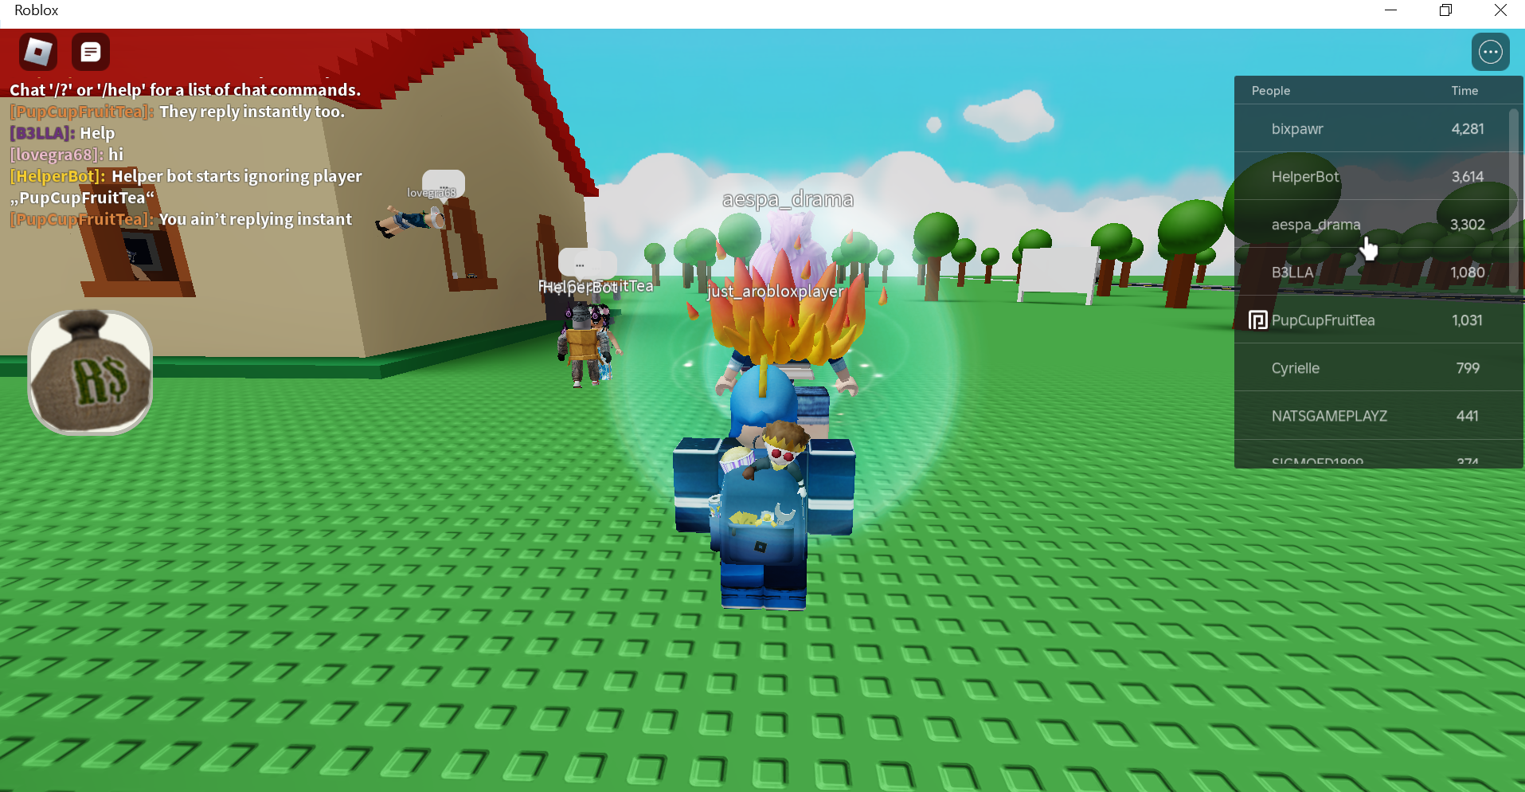
This Photo by Unknown Author is licensed under CC BY-SA-NC

Slide 19
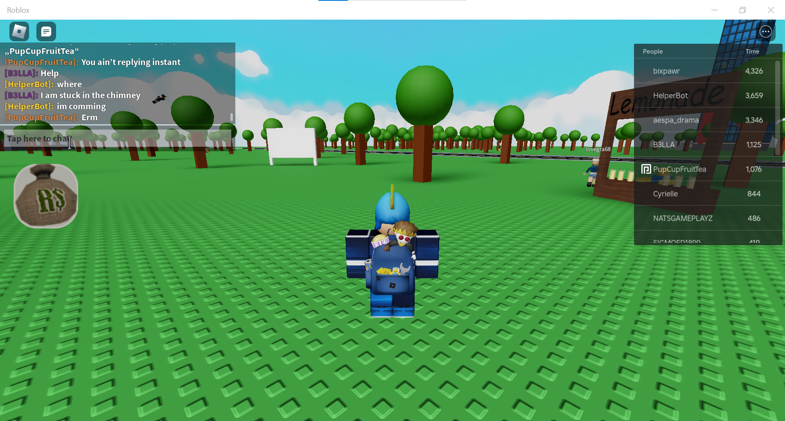
This Photo by Unknown Author is licensed under CC BY-SA-NC

Slide 20
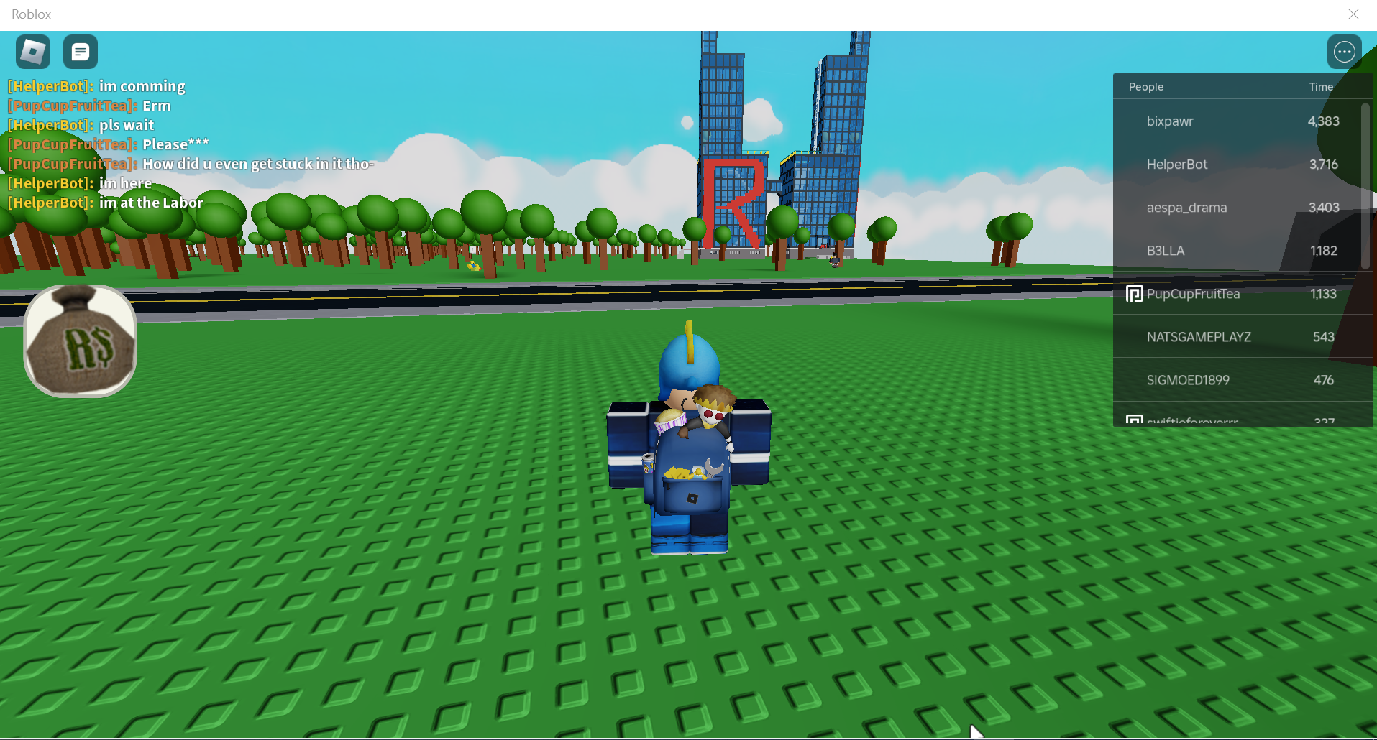
This Photo by Unknown Author is licensed under CC BY-SA-NC

